Slide 1
AI Vision Assist: Empowering the Visually Impaired

Slide 2
Project Overview: Leveraging AI to Assist the Visually Impaired
Empowering Independence
Improving Accessibility
AI vision assist empowers individuals with visual impairments to navigate their surroundings, access information, and participate in daily activities more independently.
This project aims to enhance accessibility by breaking down barriers and providing a more inclusive experience for visually impaired users.

Slide 3

Scene Understanding: Detailed Visual Descriptions
Scene Analysis
Descriptive Text
The AI analyzes the image, identifying key elements such as objects, people, and their locations.
It provides a comprehensive verbal description of the scene, helping users understand their surroundings.
Contextual Information
The AI adds context and details, like the weather, time of day, and surrounding environment.

Slide 4
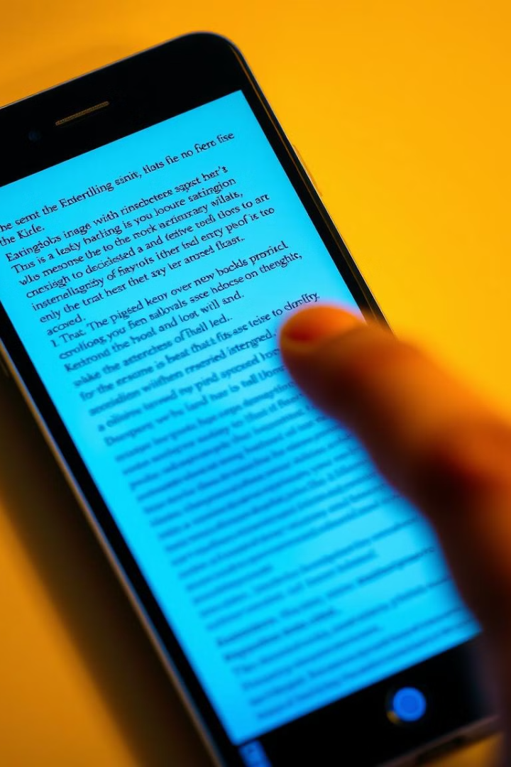



Text Extraction: Accurate OCR and Speech Conversion
Image Capture
Users can capture images of text using their smartphone cameras.
OCR Processing
Tesseract OCR technology converts the image to text with high accuracy.
Speech Output
The extracted text is converted to spoken words, making information readily accessible.

Slide 5



Improving Quality of Life: Real-World Applications
Navigation
1
AI-powered vision assist can provide guidance in unfamiliar environments.
Information Access
2
Users can gain access to important information displayed on signs, menus, and documents.
Social Engagement
3
It helps with identifying people and objects, fostering social interaction.

Slide 6
Technology Showcase: Highlighting Key Features
Google Gemini API
1
Enables advanced scene understanding and detailed visual descriptions.
Tesseract OCR
2
Provides accurate text extraction from images.
Speech Synthesis
3
Converts extracted text into clear and natural-sounding speech.

Slide 7


User Feedback and Testimonials
Improved Independence
Enhanced Information Access
Users express increased confidence and independence in navigating their environment.
The ability to access text from signs and documents has expanded their knowledge and engagement with the world.

Slide 8

Looking Ahead: Future Enhancements and Roadmap
1
2
3
Real-time Feedback
Object Recognition
Language Support
Develop a live feed of visual information for improved real-time navigation.
Expand object recognition to include everyday items and products.
Offer support for multiple languages to broaden accessibility.

